Slide 1
IMAGE FORGERY DETECTION

Slide 2
Introduction :
Following the explosion of social networking services, there has been a monumental increase in the volume of image data. Moreover, the development in image processing software such as Adobe Photoshop has given a rise to doctored images. Such doctored images can be used for malicious purposes such as spreading false information and inciting violence. This image forgery detection project allows users to detect even the slightest signs of forgery in an image.

Slide 3
There Two Modules :
Admin
User

Slide 4
The concepts of admin and user can be applied in image forgery detection systems to manage different levels of access and responsibilities. Here's an example of how these concepts can be used:
User Role:
- Image Upload: Regular users can upload images to the system for forgery detection.
- Query Results: Users can access the forgery detection results for the images they have uploaded.
- Limited Access: Users may have restricted privileges and can only view their own uploaded images and results.

Slide 5
2. Admin Role:
System Management: Administrators have the authority to manage the overall system, including user accounts, database, and settings.
Advanced Access: Admins have access to view and manage all uploaded images and results.
Algorithm Configuration: Admins can configure the forgery detection algorithms, adjust thresholds, or add new detection techniques . The admin role is responsible for maintaining the integrity and security of the forgery detection system, ensuring that users adhere to the system's guidelines, and resolving any issues that arise. The user role is focused on utilizing the system to upload images and view forgery detection results . By implementing these roles, the system can maintain a clear distinction between user responsibilities, ensuring that only authorized individuals have access to sensitive features and data. This helps protect the system from potential misuse or unauthorized modifications.

Slide 6
Images are compared as follows :
Step 1: When the admin click on the compare button both the Original and User uploaded images are converted into the black and white .
Step 2: Shape of both the images are compared first.
Step 3 : Objects of the Images are compered next
Then the Result of the image comparison will be displayed.

Slide 7
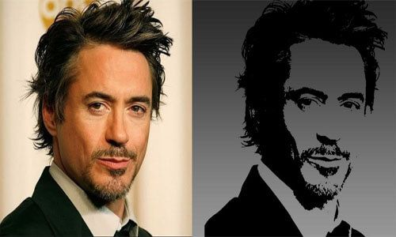
Example :

Slide 8
Image forgery detection techniques can be utilized in document verification processes to ensure the authenticity and integrity of documents. Such as
1. Signature Forgery Detection: Document verification often involves the verification of signatures. Image forgery detection algorithms can analyze the signature images and identify any signs of forgery, such as inconsistencies in stroke patterns, unnatural angles, or evidence of copy-pasting. By comparing the signature with reference samples or known genuine signatures, the system can flag potential forgeries.

Slide 9
2. Document Tampering Detection: Image forgery detection techniques can be applied to detect any tampering or alterations in the document images. For example, the system can analyze the document's visual features, such as text, logos, or stamps, to identify any discrepancies or inconsistencies that may indicate tampering. This can involve detecting spliced or cloned regions, identifying variations in text fonts or sizes, or detecting changes in document layout.
3. Watermark Verification: Watermarks are often used to protect the authenticity of documents. Image forgery detection can help verify the presence and integrity of watermarks in document images. The system can analyze the watermark patterns, positions, and transparency levels to ensure they are consistent with the original document.

Slide 10
THANK YOU

